Slide 1

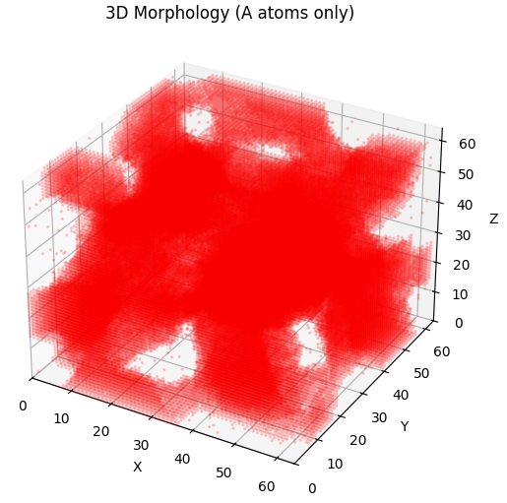

Computational Physics – Project 15.45
Vacancy mediated dynamics
in binary alloys
朱竟哲、金泊宇
2026.1.5

Slide 2

Content
Introduction
Problem Description
Model & Theory
Implementation
Microstructure Evolution
Temperature Effect
3D Simulation
Vacancy Mediated vs. Kawasaki
Conclusion
Reference

Slide 3
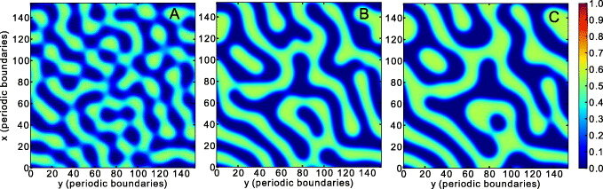
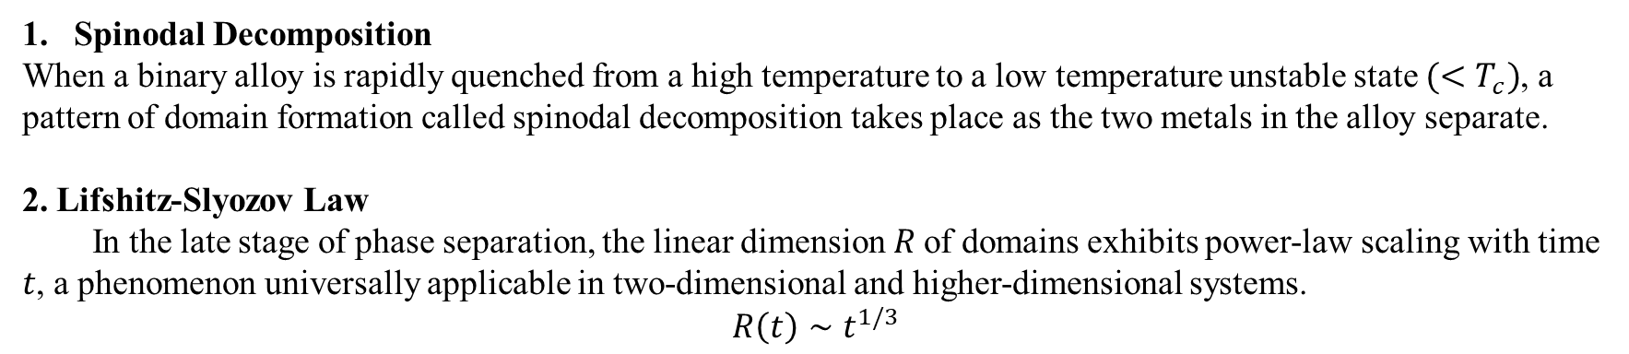
Introduction
Spinodal Decomposition
When a binary alloy is rapidly quenched from a high temperature to a low temperature unstable state ${(<T}_{c})$, a pattern of domain formation called spinodal decomposition takes place as the two metals in the alloy separate.
2. Lifshitz-Slyozov Law
In the late stage of phase separation, the linear dimension 𝑅 of domains exhibits power-law scaling with time 𝑡, a phenomenon universally applicable in two-dimensional and higher-dimensional systems.
$$R\left(t\right)∼t^{1/3}$$

Slide 4
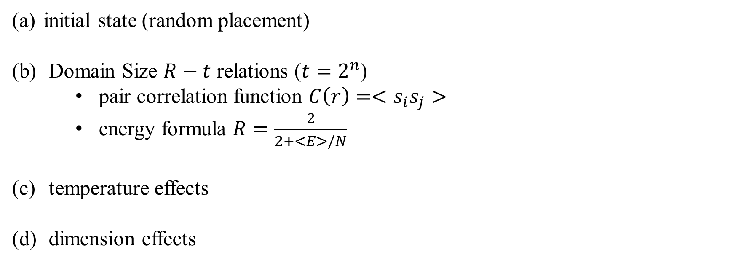
Problem Description
initial state (random placement)
Domain Size $R−t$ relations ($t=2^{n}$)
pair correlation function $C\left(r\right)=<s_{i}s_{j}>$
energy formula $R=\frac{2}{2+<E>/N}$
temperature effects
dimension effects

Slide 5
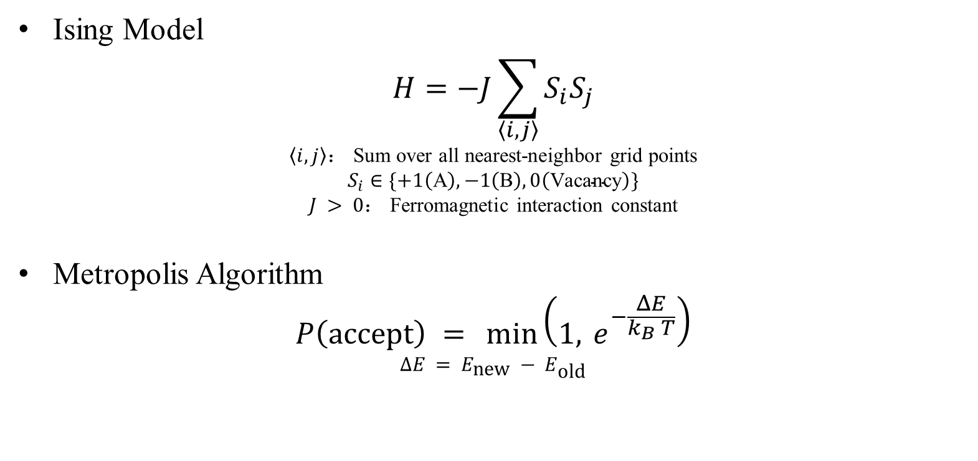
Model & Theory
Ising Model
$$H=−J\sum_{\left\langle i,j\right\rangle }{S_{i}S_{j}}$$
$\left\langle i,j\right\rangle$： Sum over all nearest-neighbor grid points
$$S_{i}∈\{+1\left(\text{A}\right),−1\left(\text{B}\right),0\left(\text{Vacancy}\right)\}$$
$J > 0$： Ferromagnetic interaction constant
Metropolis Algorithm
$$P\left(\text{accept}\right) = \min\left(1, e^{−\frac{ΔE}{k_{B} T}}\right)$$
$$ΔE = E_{\text{new}} − E_{\text{old}}$$

Slide 6
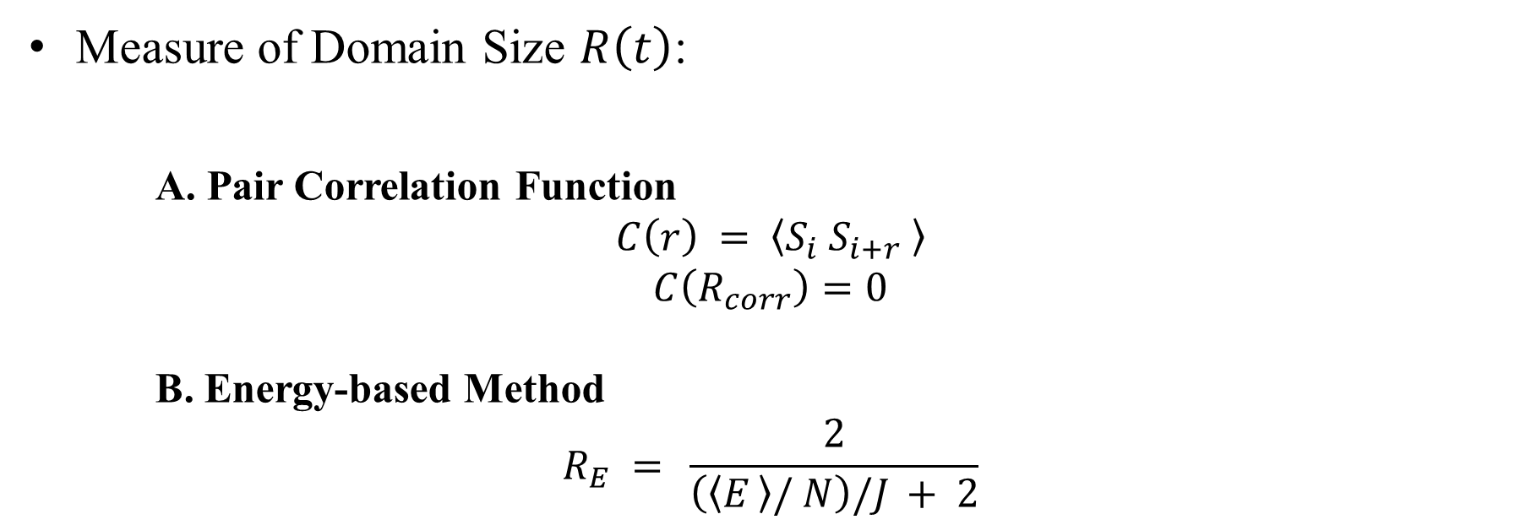
Model & Theory
Measure of Domain Size $R\left(t\right)$:
A. Pair Correlation Function
$$C\left(r\right) = \left\langle S_{i} S_{i+r} \right\rangle$$
$$C\left(R_{corr}\right)=0$$
B. Energy-based Method
$$R_{E} = \frac{2}{\left(\left\langle E \right\rangle / N\right)/J + 2}$$

Slide 7
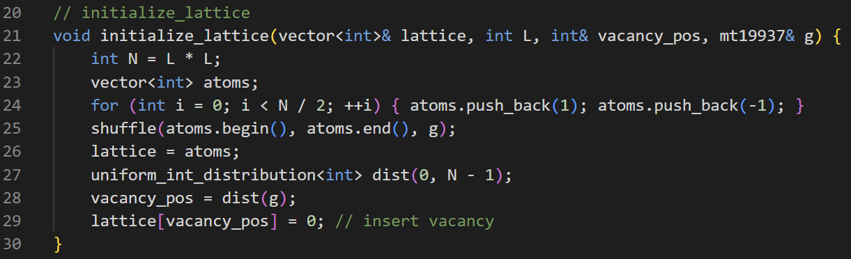
Implementation - Initialize Lattice
Generate equal quantities
of A and B atoms
Random placement
Insert vacancy
Notes:
4. 代码实现与算法解析 (Implementation)
对应章节：4.1 - 4.3
核心内容：
基础架构：周期性边界条件。
核心引擎：空位追踪技术（只更新局部能量，高效）。
数据采样：对数时间采样策略。

Slide 8
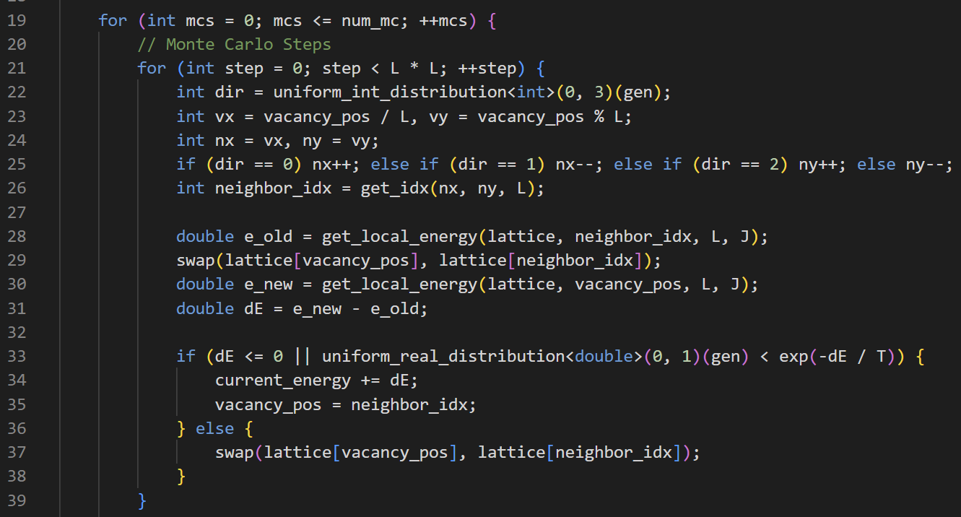
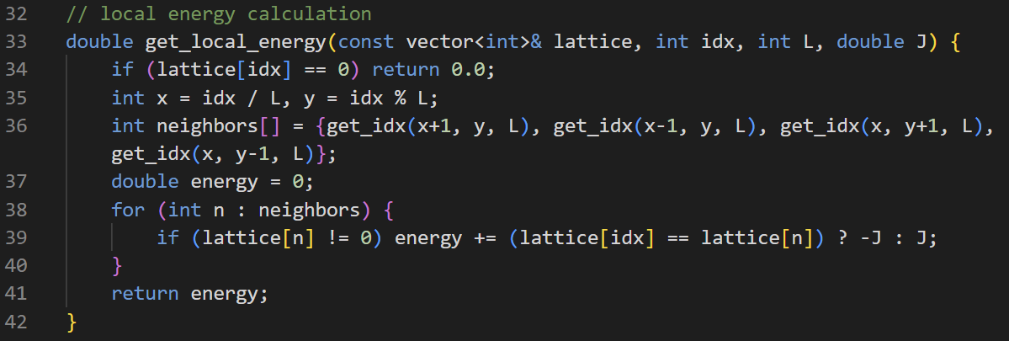
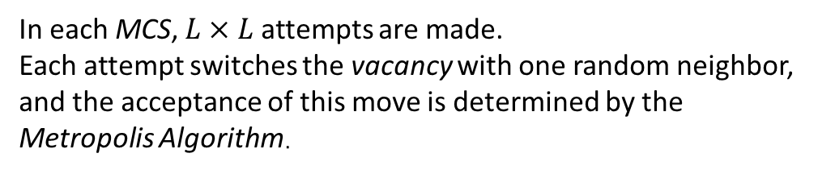
Implementation - Metropolis Algorithm
To improve efficiency, we calculate only the local energy difference involving exchange, rather than the total system energy.
Vacancy do not contribute to the interaction energy.
In each MCS, $L×L$ attempts are made.
Each attempt switches the vacancy with one random neighbor, and the acceptance of this move is determined by the Metropolis Algorithm.
Notes:
4. 代码实现与算法解析 (Implementation)
对应章节：4.1 - 4.3
核心内容：
基础架构：周期性边界条件。
核心引擎：空位追踪技术（只更新局部能量，高效）。
数据采样：对数时间采样策略。

Slide 9
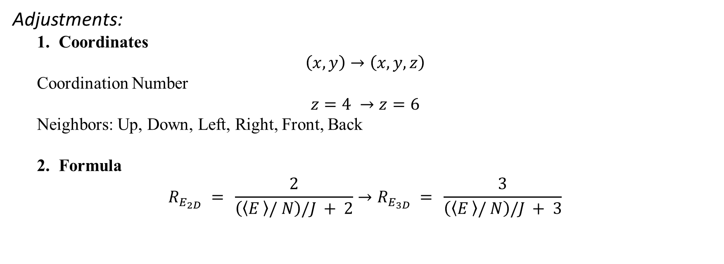
Implementation – 3D Circumstance
Adjustments:
1. Coordinates
$$\left(x,y\right)→\left(x,y,z\right)$$
Coordination Number
$$z=4 →z=6$$
Neighbors: Up, Down, Left, Right, Front, Back
2. Formula
$$R_{E_{2D}} = \frac{2}{\left(\left\langle E \right\rangle / N\right)/J + 2}→R_{E_{3D}} = \frac{3}{\left(\left\langle E \right\rangle / N\right)/J + 3}$$
Notes:
4.4 三维情形 (3D Implementation)
对应章节：4.4 三维情形
核心内容：坐标映射升级 ($x,y \to x,y,z$)。
配位数变化 ($4 \to 6$)。
$R$ 计算公式修正 (系数 $2 \to 3$)。

Slide 10
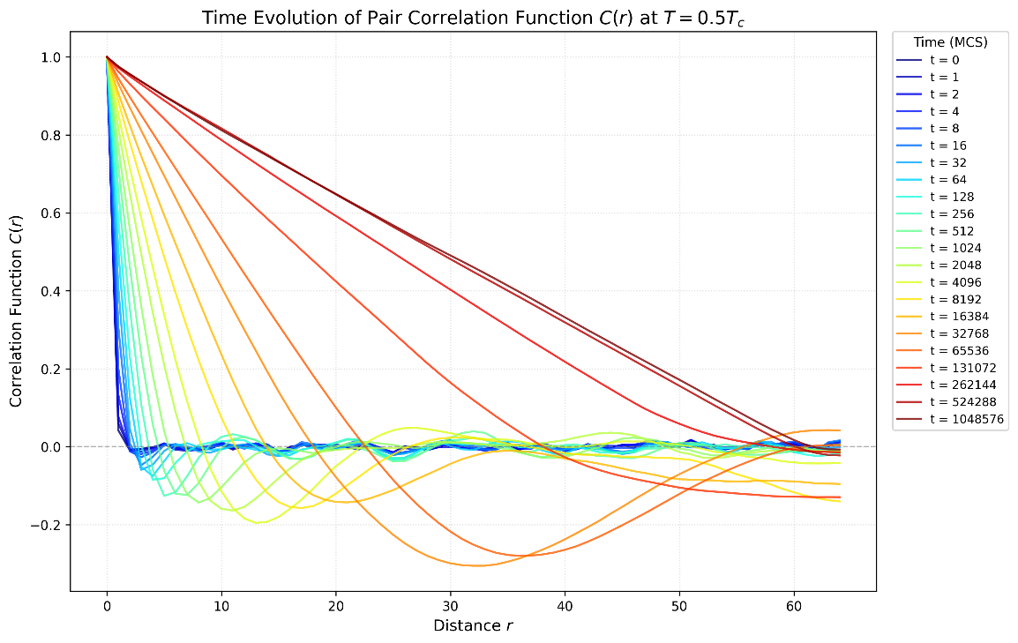
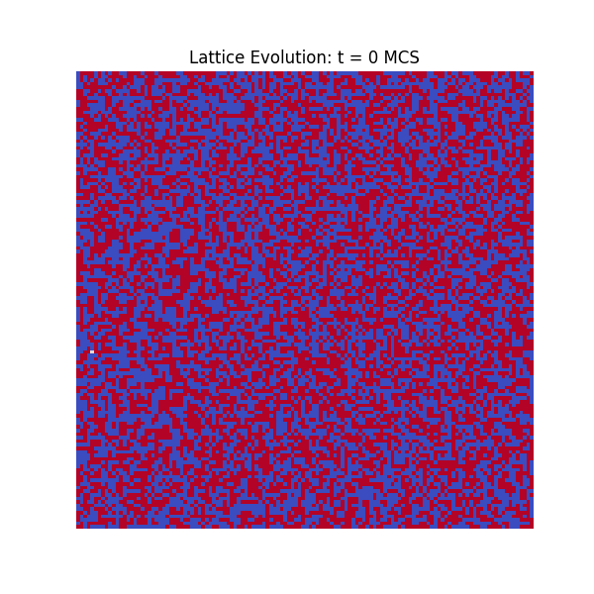
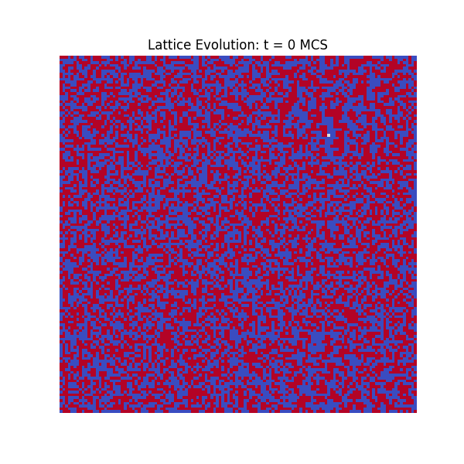
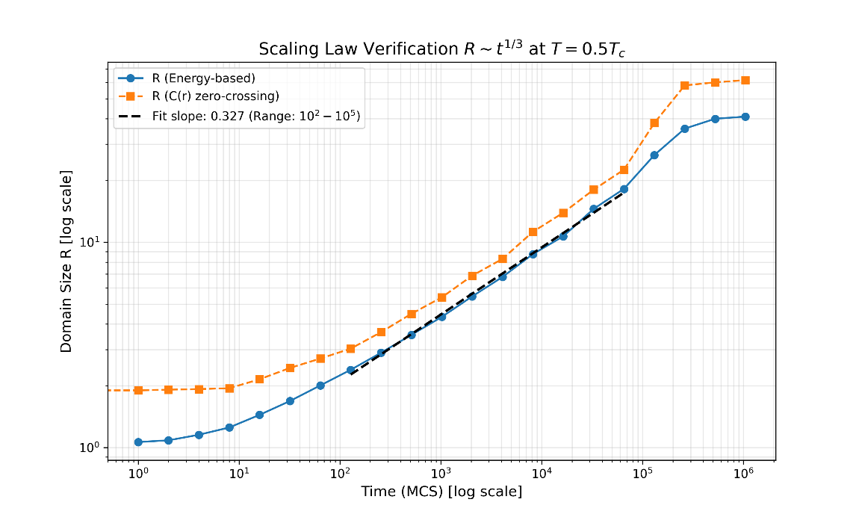
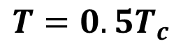

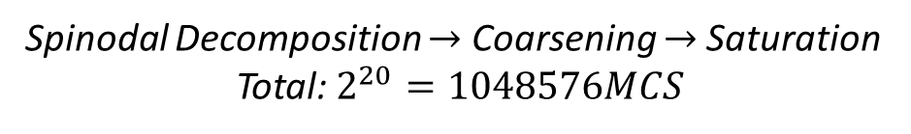
Microstructure Evolution
$$T=0.5T_{c}$$
Spinodal Decomposition $→$ Coarsening $→$Saturation
Total: $2^{20}=1048576MCS$
$$n ≈0.327$$
Notes:
微观结构演化 (Microstructure Evolution)
对应章节：5.1 微观结构演化 ⁷
核心内容：展示 $T=0.5T_c$ 下的四张演化快照 ($t=0 \to 10^6$)。
讲稿要点：旋节分解 $\to$ 粗化 $\to$ 饱和（条带状）。
畴生长标度律验证 (Scaling Law Verification)
对应章节：5.2 畴生长标度律验证 ⁸
核心内容：
左图：关联函数 $C(r)$ 随时间演化。
右图：双对数坐标下的 $R(t)$ 拟合。
结论：$n \approx 0.326$，完美验证理论值 $1/3$。

Slide 11
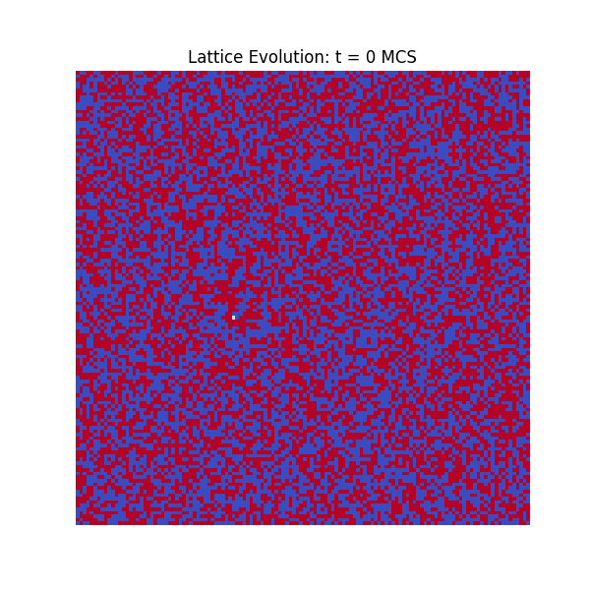
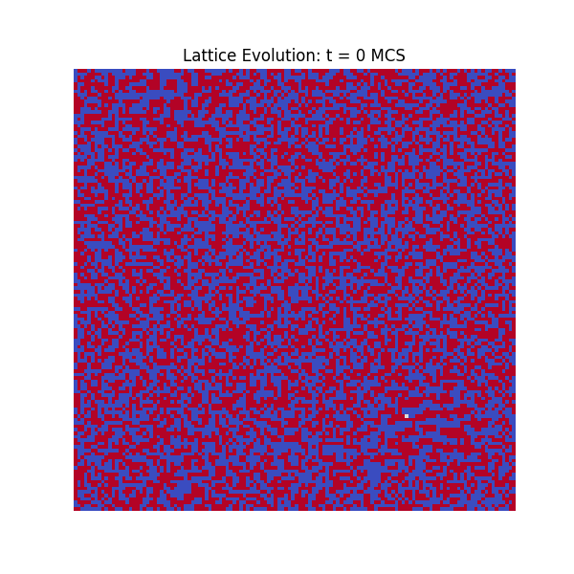
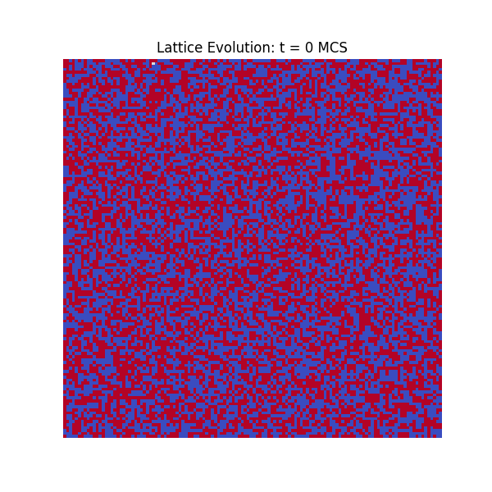
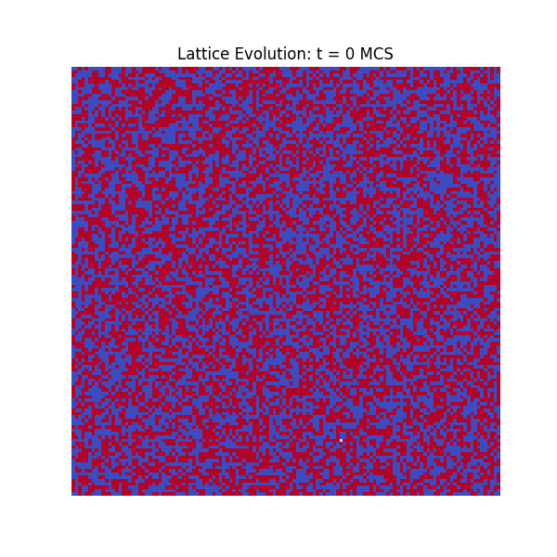




Temperature Effects
$$T=0.2T_{c}$$
$$T=0.7T_{c}$$
$$T=1.0T_{c}$$
$$T=1.5T_{c}$$
Phase separation
Critical
Disordered
Notes:
5.3 温度影响与相变 (Temperature Effects)
对应章节：5.3 温度影响与相变 ⁹
核心内容：
拼图：展示 $0.2, 0.7, 1.0, 1.5 T_c$ 四种微观结构。
数据：对比“冻结 ($0.2$)”和“无序 ($1.5$)”的生长曲线。
结论：清晰划分出 相分离区、临界区、无序区。

Slide 12
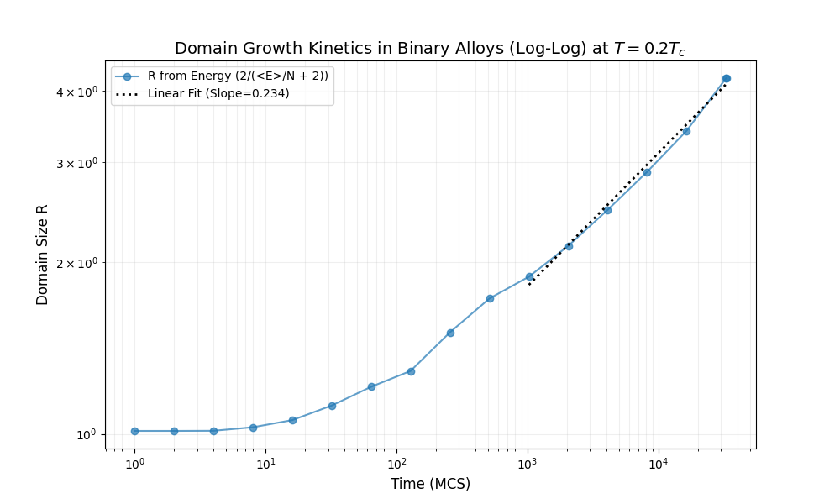
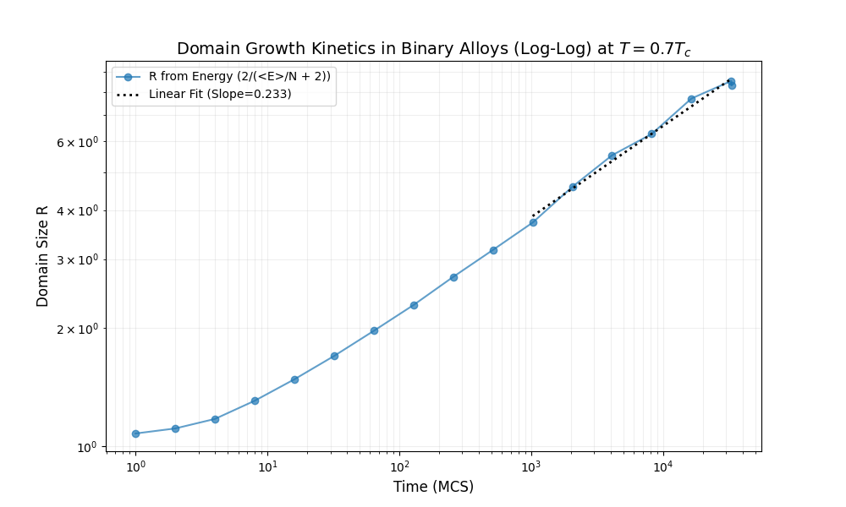
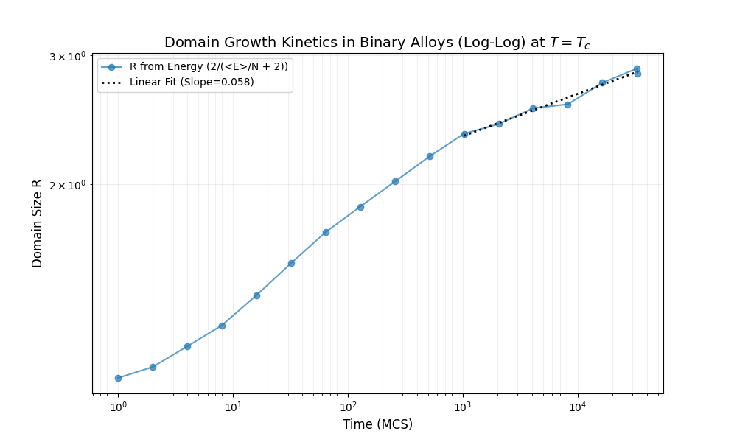
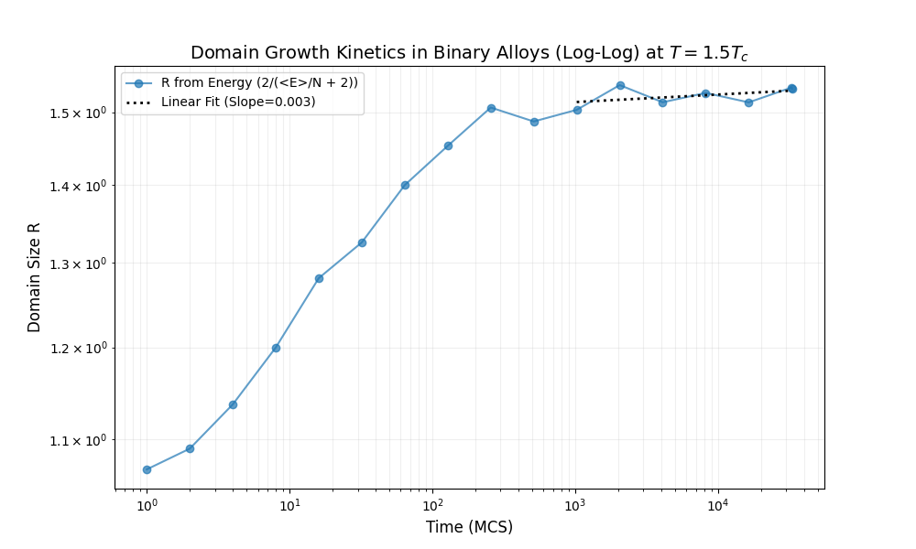
Temperature Effects – Domain Growth
Notes:
5.3 温度影响与相变 (Temperature Effects)
对应章节：5.3 温度影响与相变 ⁹
核心内容：
拼图：展示 $0.2, 0.7, 1.0, 1.5 T_c$ 四种微观结构。
数据：对比“冻结 ($0.2$)”和“无序 ($1.5$)”的生长曲线。
结论：清晰划分出 相分离区、临界区、无序区。

Slide 13
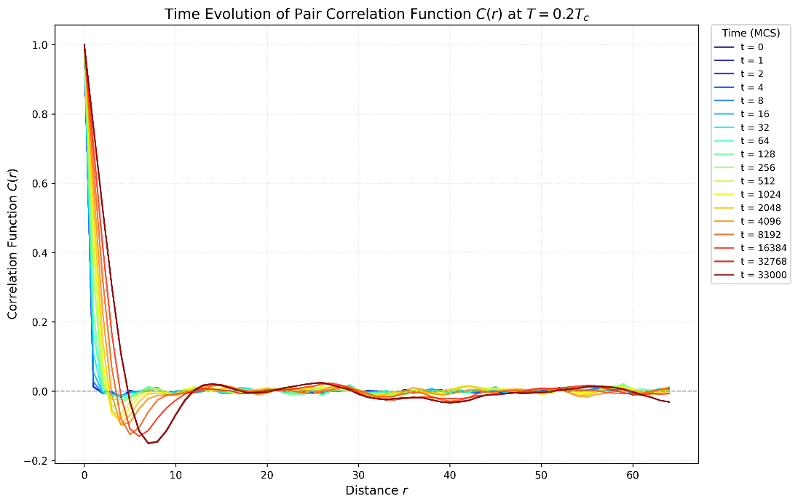
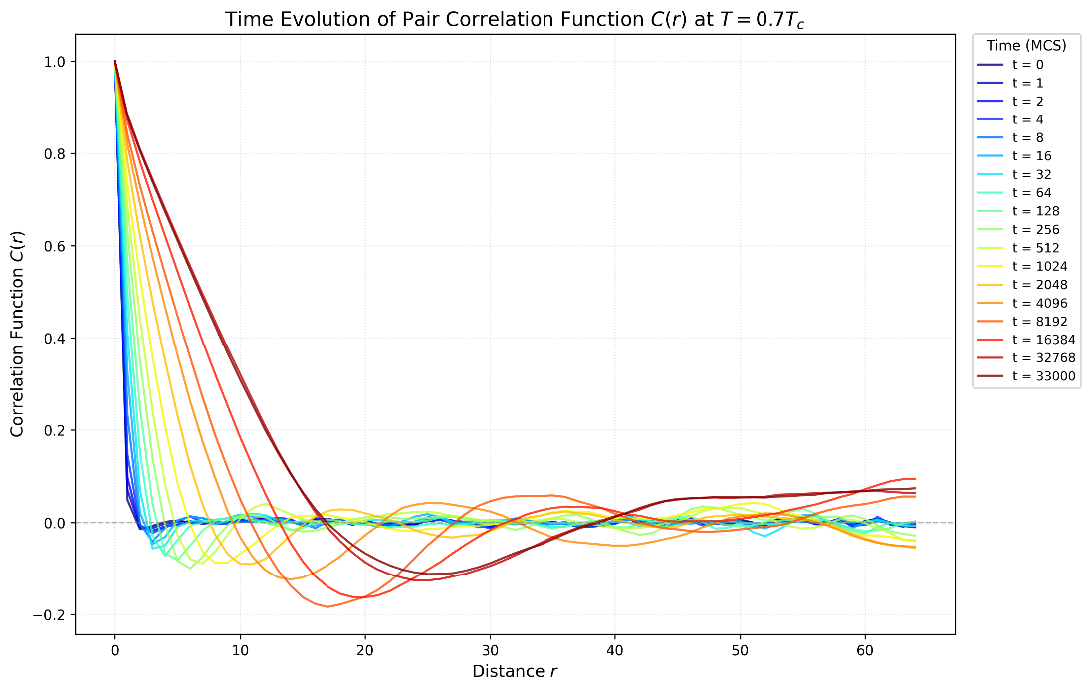
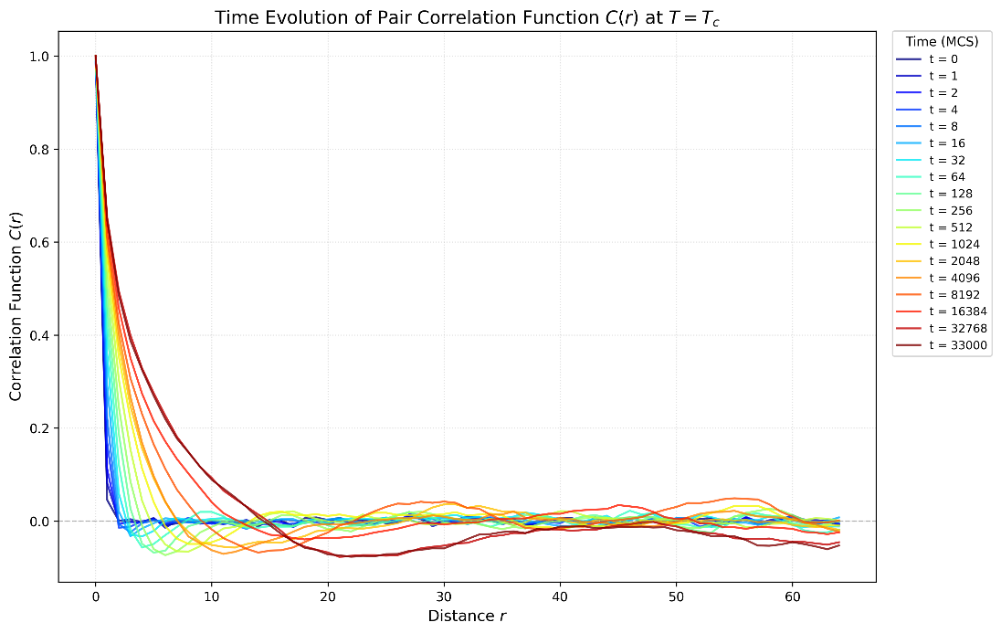
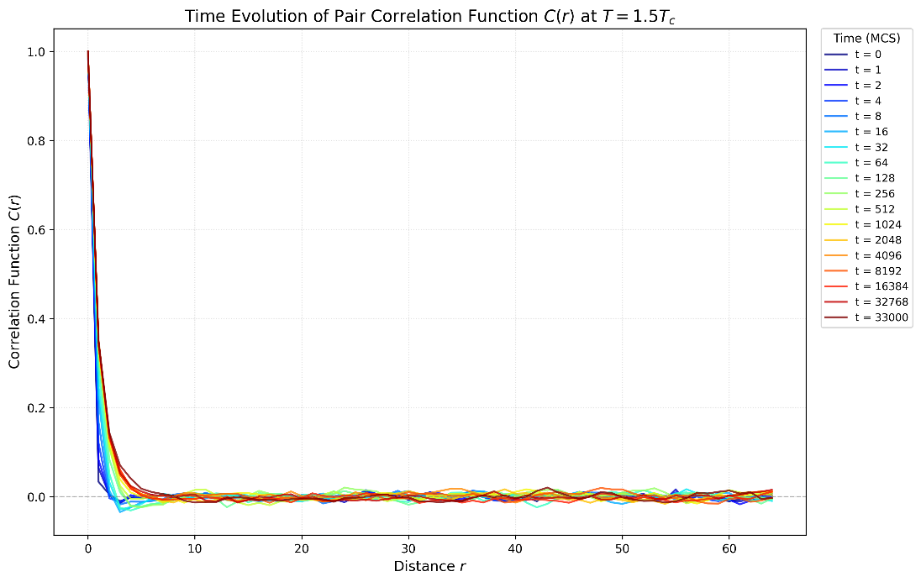
Temperature Effects – Pair Correlation Function
Notes:
5.3 温度影响与相变 (Temperature Effects)
对应章节：5.3 温度影响与相变 ⁹
核心内容：
拼图：展示 $0.2, 0.7, 1.0, 1.5 T_c$ 四种微观结构。
数据：对比“冻结 ($0.2$)”和“无序 ($1.5$)”的生长曲线。
结论：清晰划分出 相分离区、临界区、无序区。

Slide 14
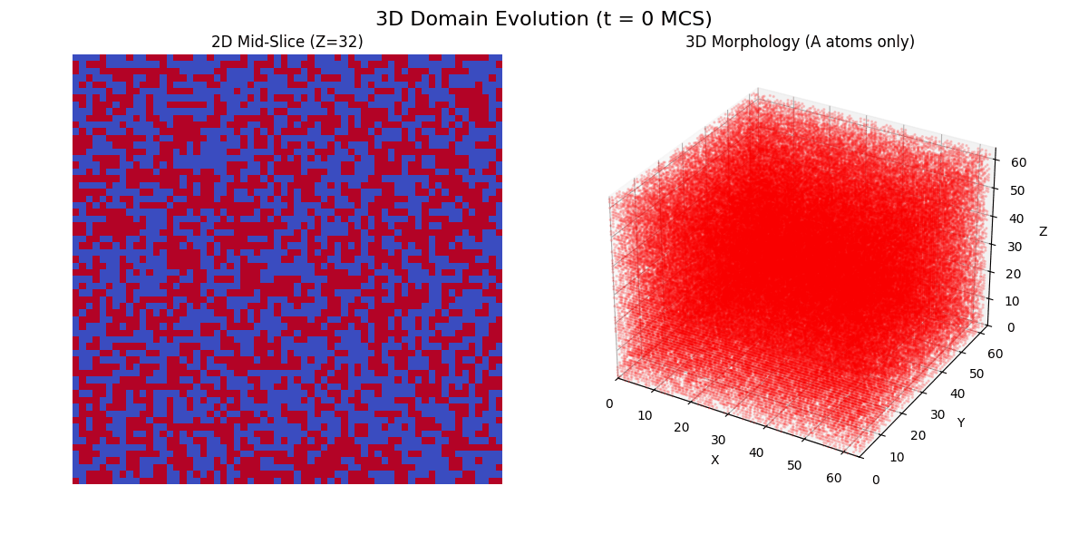
3D Simulation
Notes:
5.4 维度效应与三维模拟 (3D Simulation)
对应章节：5.4 维度效应与三维模拟 ¹⁰
核心内容：
展示炫酷的 3D 演化图。
展示 3D 的标度律拟合结果 ($n \approx 0.281$)。
结论：普适性验证成功。

Slide 15
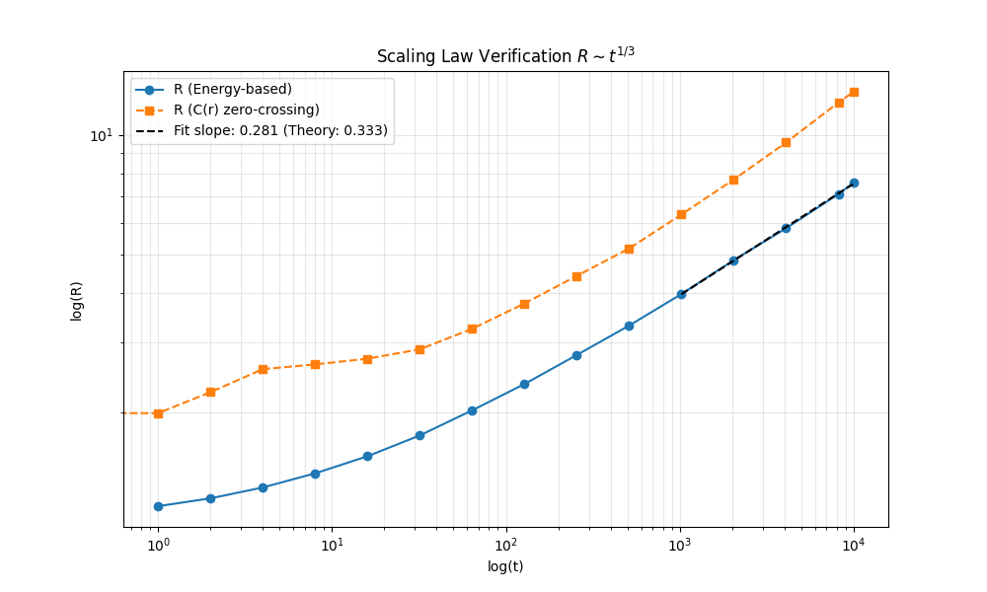
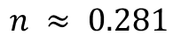
3D Simulation
$$n ≈ 0.281$$
Notes:
5.4 维度效应与三维模拟 (3D Simulation)
对应章节：5.4 维度效应与三维模拟 ¹⁰
核心内容：
展示炫酷的 3D 演化图。
展示 3D 的标度律拟合结果 ($n \approx 0.281$)。
结论：普适性验证成功。

Slide 16
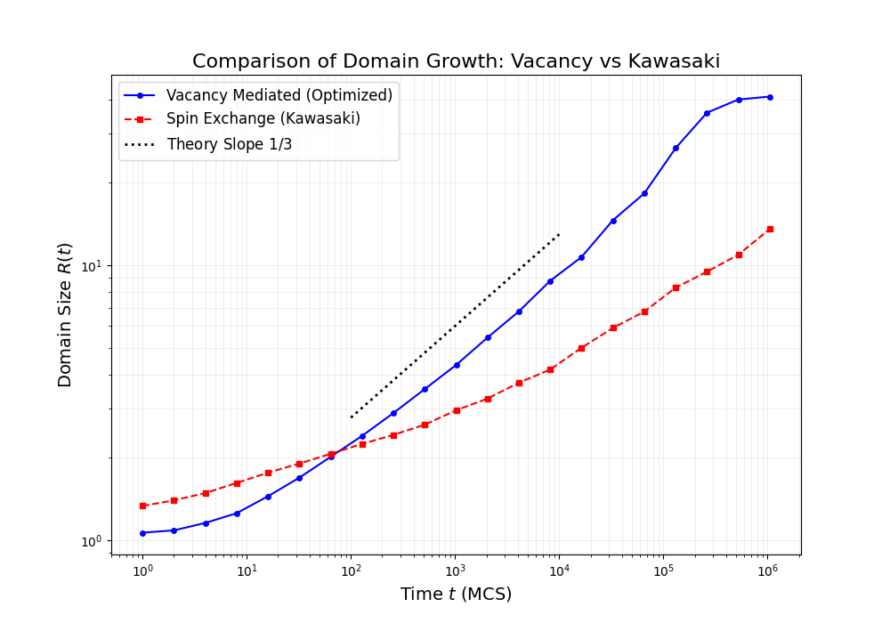
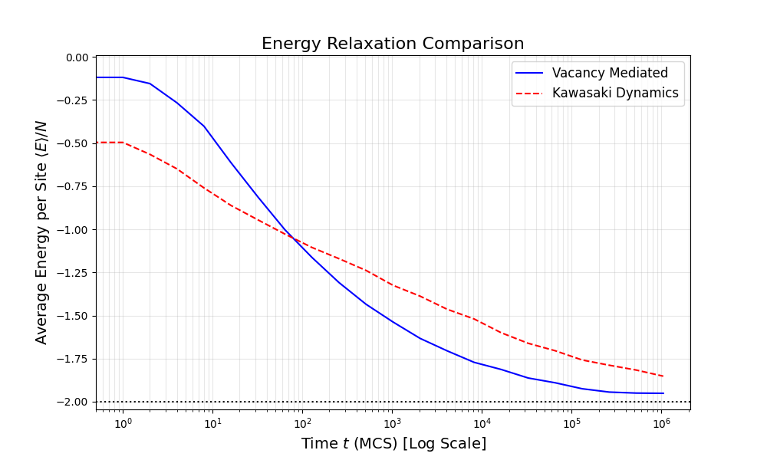
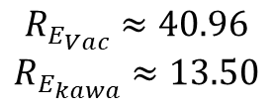
Vacancy Mediated vs. Kawasaki
Evolution Efficiency: Growth & Energy
$$R_{E_{Vac}}≈40.96$$
$$R_{E_{kawa}}≈13.50$$
Notes:
5.5 算法对比
动力学对比（速度）
标题：Evolution Efficiency: Growth & Energy
文字：强调生长快（$R$ 曲线）和能量释放快（$E$ 曲线）。
图片：compare_1_growth.png 和 compare_3_energy.png 。

Slide 17
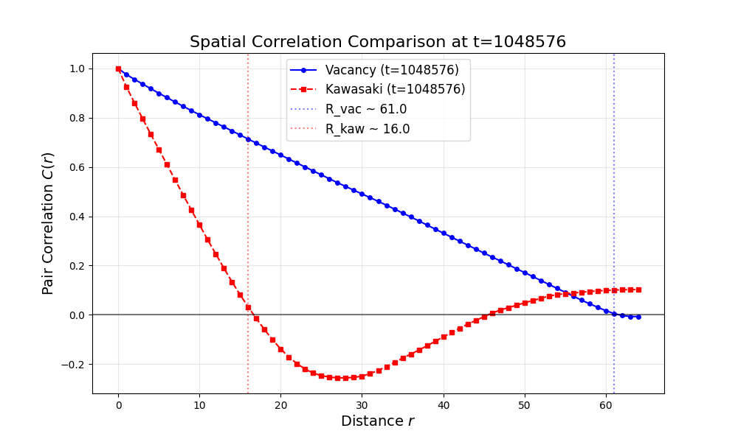
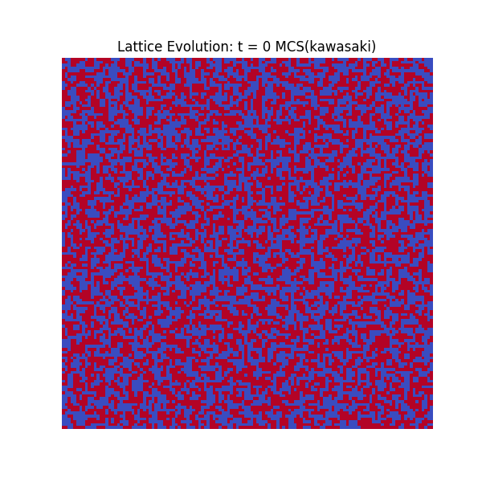
Vacancy Mediated vs. Kawasaki
Structural Analysis: Correlation & Morphology
Notes:
5.5 算法对比
结构对比（质量）
标题：Structural Analysis: Correlation & Morphology
文字：强调空位法能形成长程有序结构（关联函数零点远），而 Kawasaki 还在短程纠缠。
图片：compare_4_correlation.png 和 compare_2_snapshots_t1048576.png。

Slide 18
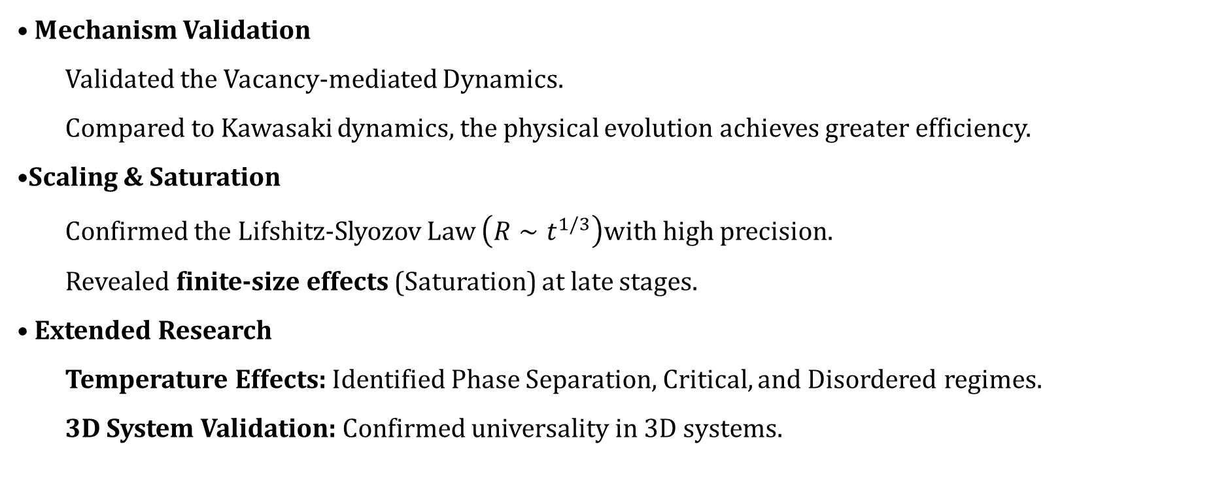
Conclusion
Mechanism Validation
Validated the Vacancy-mediated Dynamics.
Compared to Kawasaki dynamics, the physical evolution achieves greater efficiency.
Scaling & Saturation
Confirmed the Lifshitz-Slyozov Law $\left(R∼t^{1/3}\right)$with high precision.
Revealed finite-size effects (Saturation) at late stages.
Extended Research
Temperature Effects: Identified Phase Separation, Critical, and Disordered regimes.
3D System Validation: Confirmed universality in 3D systems.
Notes:
6. 结论 (Conclusion)
对应章节：6 结论
核心内容：
机制：空位介导动力学有效。
标度律：二维精确验证 $R \sim t^{1/3}$。
相图：完整复现了不同温度和维度下的动力学行为。

Slide 19
Reference
[1] I.M. Lifshitz, V.V. Slyozov,The kinetics of precipitation from supersaturated solid solutions,Journal of Physics and Chemistry of Solids,Volume 19, Issues 1–2,1961,Pages 35-50, ISSN 0022-3697
[2] Shrivastava, S., & Singh, A. (2023). Phase separation kinetics of binary mixture in the influence of bond disorder: sensitivity to quench temperature. Phase Transitions, 96(5), 311–327.
[3] PhysRevLett.46.1581, Domain Growth of Degenerate Phases, Safran, S. A.}, Phys. Rev. Lett. volume46, issue 24, pages1581--1584, numpages 0, year 1981, month Jun, publisher AmericanPhysicalSociety.doi10.1103/PhysRevLett.46.1581.
[4] K. Yaldram and K. Binder. Spinodal decomposition of a two-dimensional model alloy with mobile vacancies. Acta Metallurgica et Materialia, 39(4): 707-717, 1991.
[5] K. Binder and D. W. Heermann. Monte Carlo Simulation in Statistical Physics: An Introduction. Springer, Berlin, 5th edition, 2010.
[6] A. J. Bray. Theory of phase-ordering kinetics. Advances in Physics, 43(3): 357-459, 1994.
Notes:
Reference

Slide 20
Thank you for your listening ！
算法构建、代码实现、数据模拟：金泊宇
数据模拟、结果分析、报告撰写：朱竟哲

